Slide 1
Outfit Lab
We’ve got you covered
Want a personal stylist for your wardrobe

Slide 2


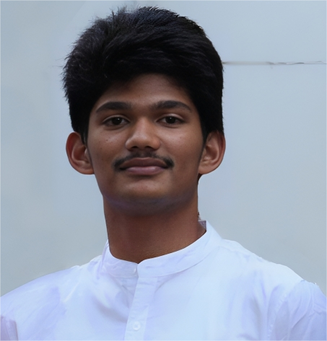
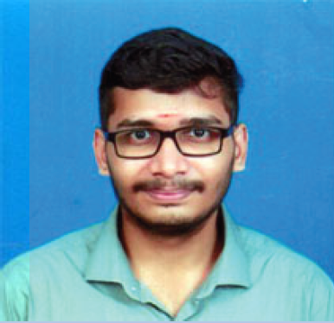

Team Members
Dr Premjith B
Ippatapu Venkata Srichandra
Harish Vijay V
Pathange Omkareshwara Rao
Amrit Subramanian

Slide 3
Introduction to Personalized Fashion Recommendation System
Objective: Create a personalized fashion recommendation system based on users' wardrobes and event preferences.
Key Components: FastAPI, Firebase, Qdrant VectorDB, CLIP model, Neo4j, FashionGAN.

Slide 4
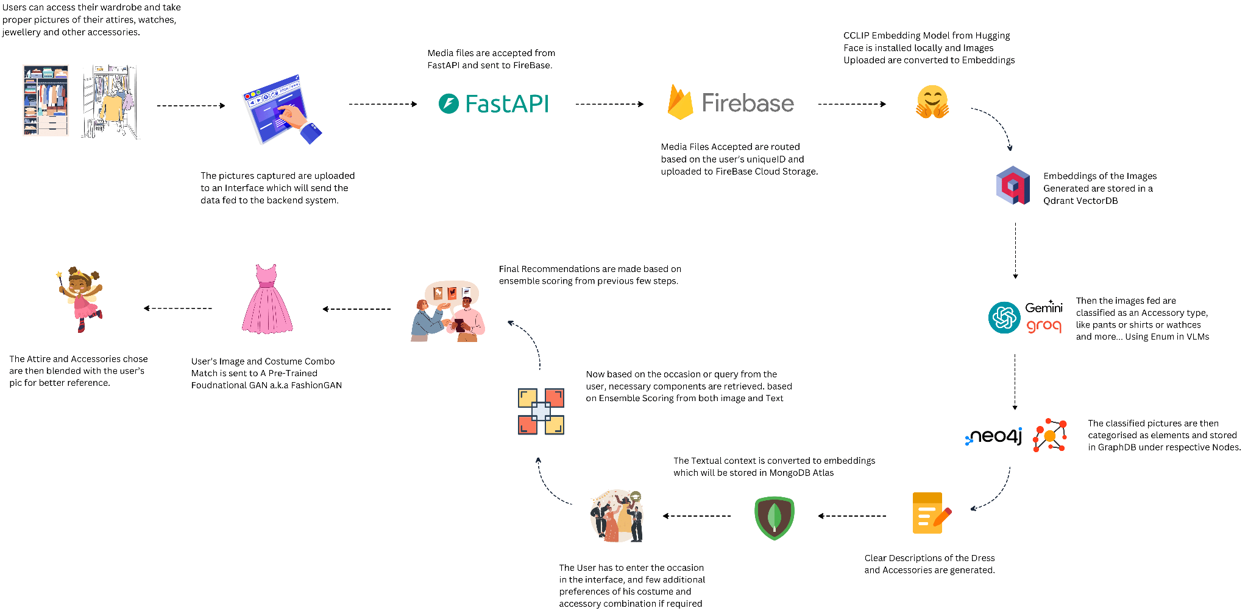
work-flow

Slide 5
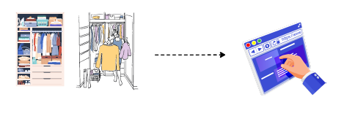
Step 1 – User Input and Wardrobe Access
User Interaction:
Users take pictures of their clothing, accessories, wardrobe items and body image.
Images are captured with clear views of attire, watches, jewelry, and other accessories.
Interface:
Images are uploaded via an interface that sends data to the backend system using FastAPI.

Slide 6

Step 2 – Uploading Images to Firebase
Image Handling:
Media files (clothing images) are accepted from FastAPI.
Images are routed based on the user’s unique ID and uploaded to Firebase Cloud Storage for further processing.
security is ensured by storing images in Firebase Cloud Storage organized by user IDs. This system allows for secure, user-specific storage and access to wardrobe images.

Slide 7

Step 3 – Embedding Creation Using CLIP Model
Image Embedding:
A CLIP Embedding Model from Hugging Face is installed locally.
Uploaded images are converted into embeddings (vector representations) using the CLIP model.
These embeddings are a combination of image and text descriptions.

Slide 8
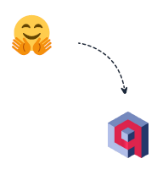
Step 4 – Embedding Storage in Qdrant VectorDB
VectorDB:
The embeddings generated from the images are stored in a Qdrant VectorDB.
This allows for fast, scalable access to image embeddings based on user queries.

Slide 9
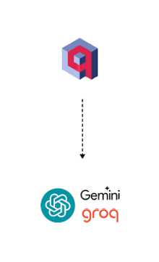
Step 5 – Image Classification Using Gemini Groq
Classification:
The images are classified as accessory types (pants, shirts, watches, etc.) using Enum in Vision Language Models (VLMs) from Gemini Groq.
This classification helps in organizing the wardrobe items for easier retrieval

Slide 10
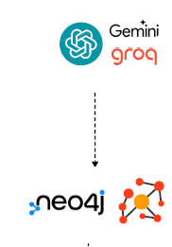
Step 6 – Storage in Neo4j GraphDB
GraphDB Storage:
The classified items are stored in a Neo4j Graph Database under respective nodes (e.g., shirts, pants, accessories).
This creates a structured representation of the user’s wardrobe.

Slide 11

Step 7 – User Occasion Input and Query Handling
Occasion-Based Query:
The user inputs the occasion (e.g., wedding, party) and any specific preferences for the outfit.
Textual input is converted to embeddings using a pre-trained model and stored in MongoDB Atlas.
The embeddings are generated based on both text and image to ensure relevance.

Slide 12
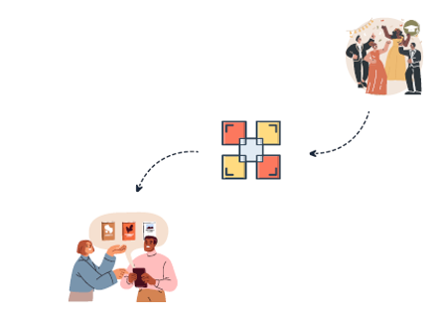
Step 8 – Ensemble Scoring for Recommendations
Recommendation Generation:
Recommendations are made based on ensemble scoring of both image and text embeddings.
This ensures the best match for the user's preferences and occasion.

Slide 13
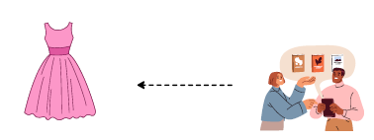
Step 9 – Visualizing with FashionGAN
Visualization:
The user’s selected attire and accessories are sent to a pre-trained FashionGAN model.
The GAN model blends the user’s image with the outfit to create a visualization of how they will look in the recommended attire.

Slide 14
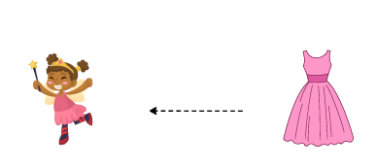
Step 10 – Final Attire Recommendations
Final Step:
The user is presented with attire and accessory combinations that suit their input preferences.
The final recommendations are displayed with visual references for better decision-making.

Slide 15
Initial Results:
Image Upload & Storage:
Successfully implemented an interface where users can upload images of their wardrobe and body.
Images are uploaded via FastAPI and stored in Firebase for easy media management.
Embedding Generation:
Images are processed using the CLIP embedding model from Hugging Face to generate embeddings that capture key features like color, texture, and style.
Efficient Embedding Storage:
Embeddings are stored in Qdrant VectorDB, enabling fast and efficient retrieval during the recommendation process.
Image Classification:
Integrated Gemini groq to classify items such as shirts, pants, watches, belts, and other accessories.
Knowledge Graph Management:
Created a knowledge graph in Neo4j, categorizing wardrobe items and accessories into respective nodes for structured, intuitive recommendations.

Slide 16
Yet-To-Do
Backend Efficiency Optimization: Refined storage systems to improve performance and scalability. Enhanced the data pipelines for smoother flow and faster retrieval.
Knowledge Graph Improvement: Continued building and refining the Neo4j knowledge graph to link related clothing items and accessories, ensuring more intuitive and accurate outfit selection.
Accessory Recommendations Enhancement: Focused on improving recommendations for watches, belts, jewelry, and other accessories. Fine-tuned the embedding and classification processes for better integration of accessories into outfit suggestions.

Slide 17
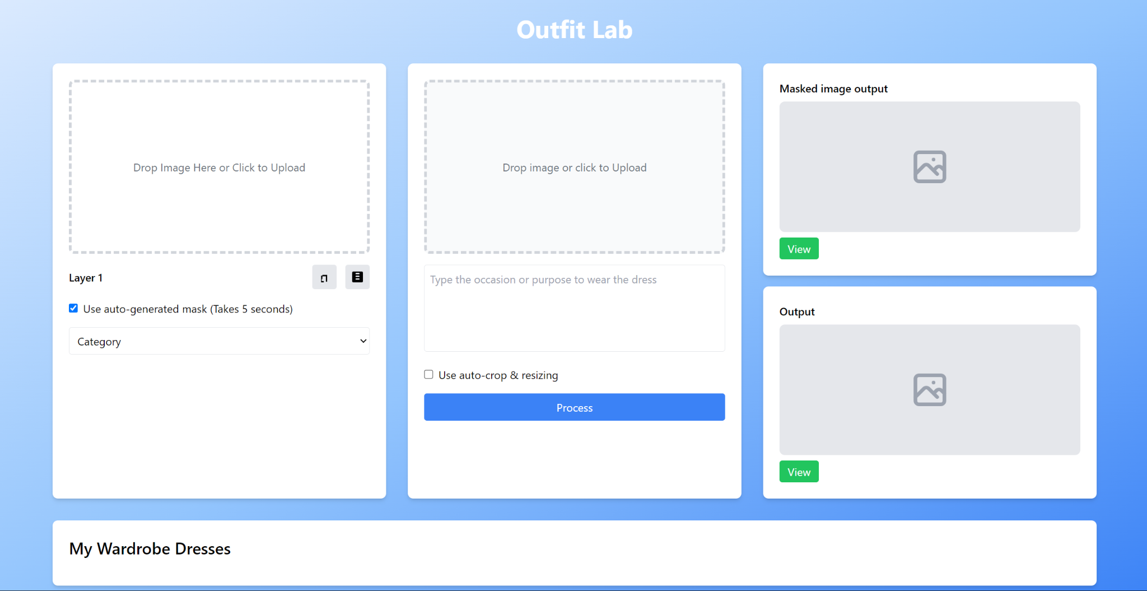
Results

Slide 18
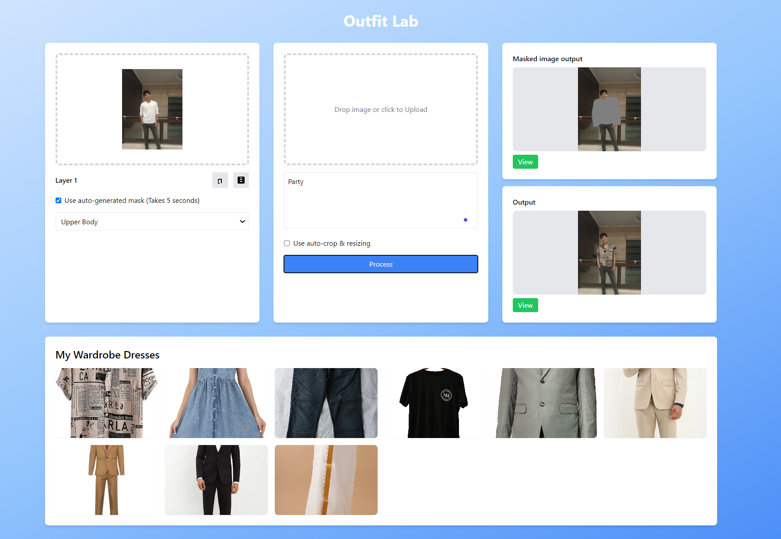
Results

Slide 19
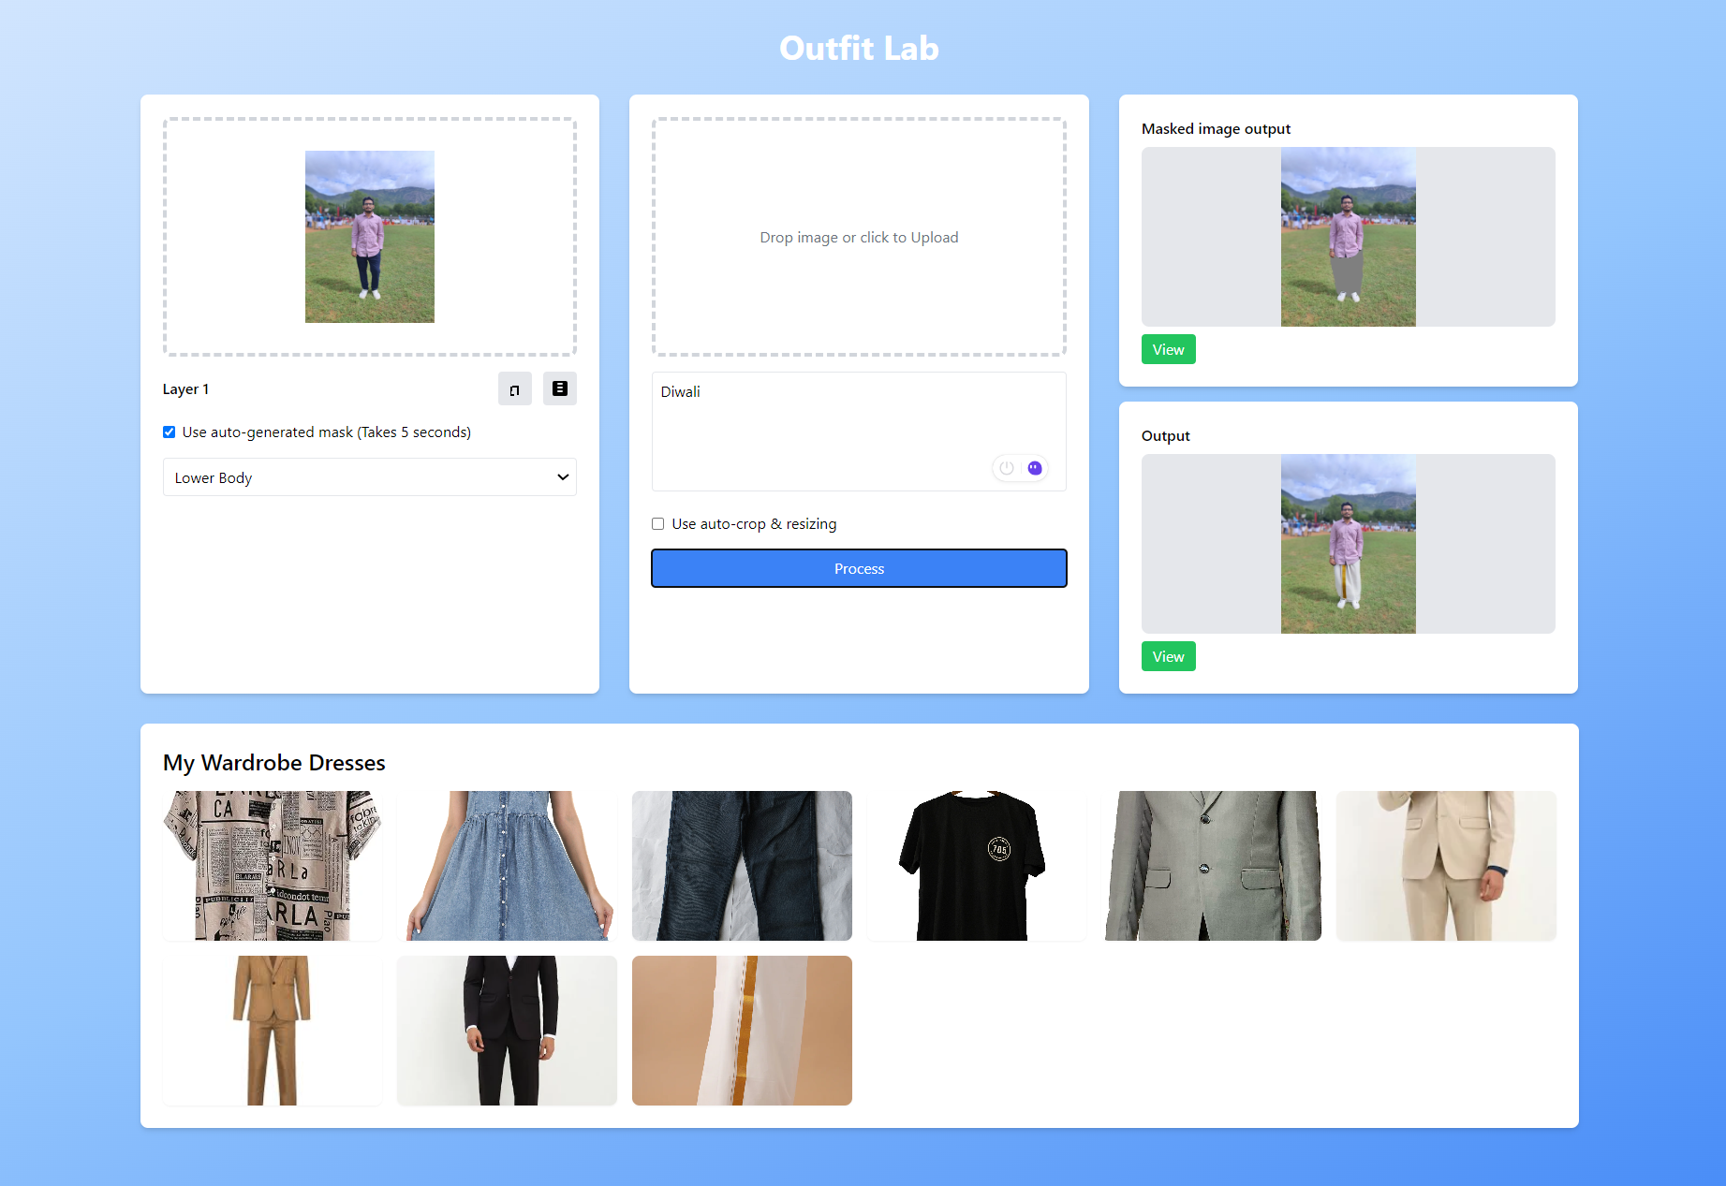
Results

Slide 20
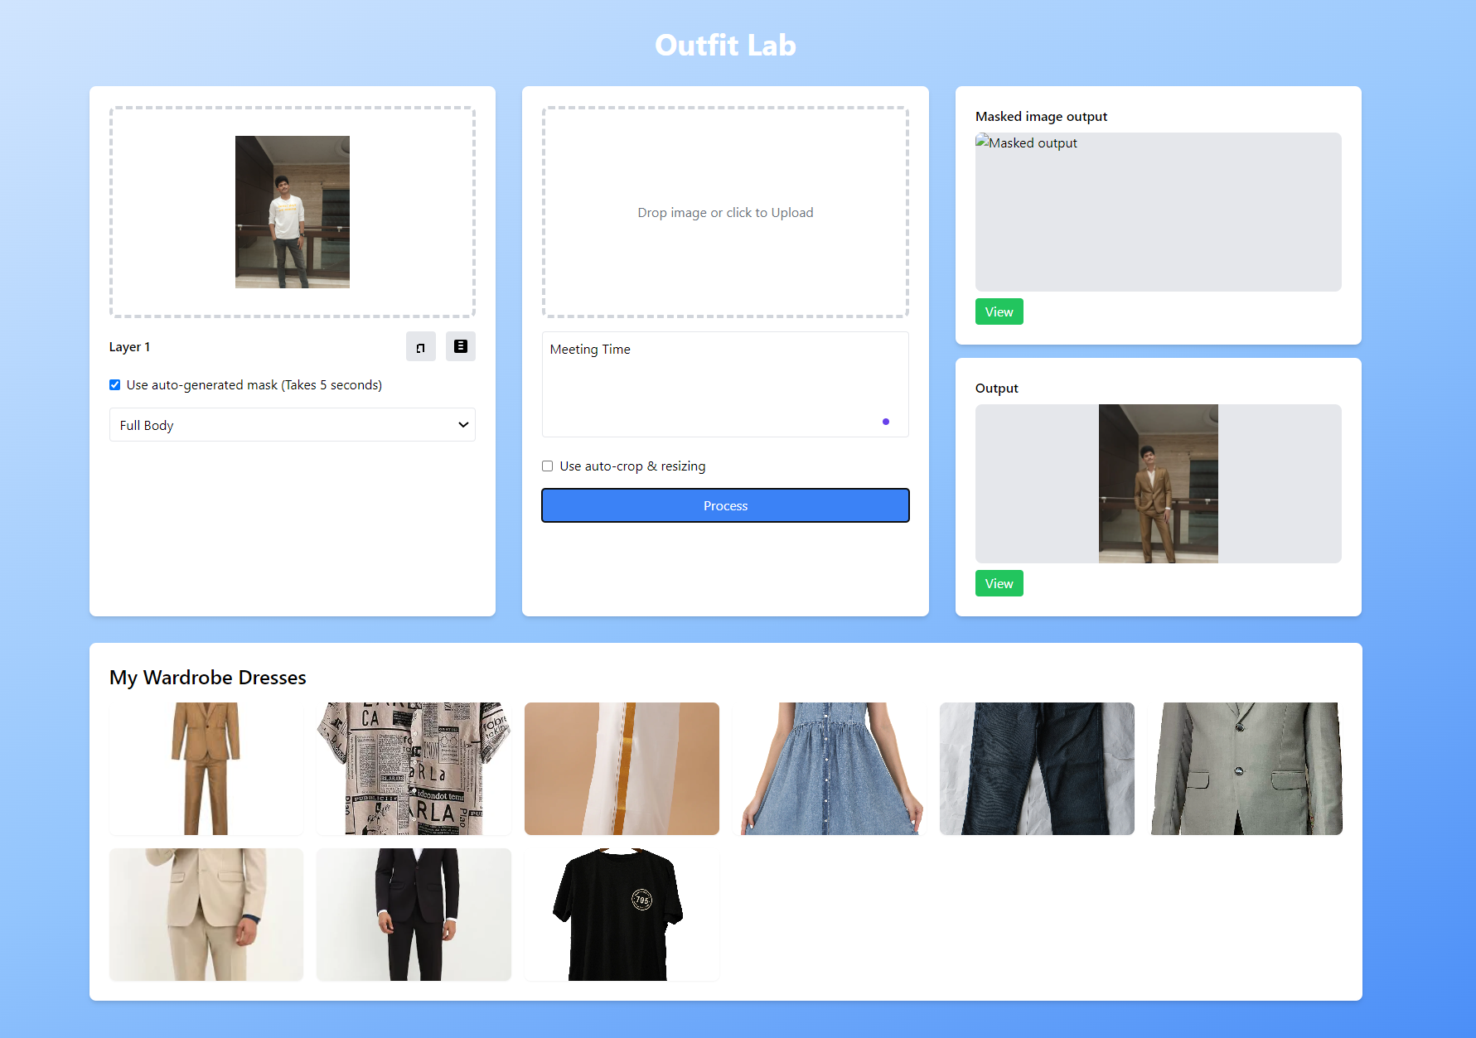
Results

Slide 21
Thank You

